Slide 1

Digital Design and Verification Training
System Verilog 3 and AXI Protocol

Slide 2
Agenda

Slide 3
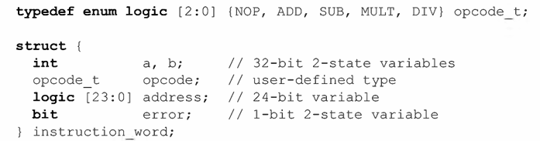
Structures
A structure is used to group together multiple variables under a common name.
Notes:
Use a struct when you just need to group related signals inside a module/class.
Use an interface when you want to connect multiple modules with a clean, single port and possibly embed protocol behavior.

Slide 4

Structures
Assigning to structure members
Notes:
Use a struct when you just need to group related signals inside a module/class.
Use an interface when you want to connect multiple modules with a clean, single port and possibly embed protocol behavior.

Slide 5
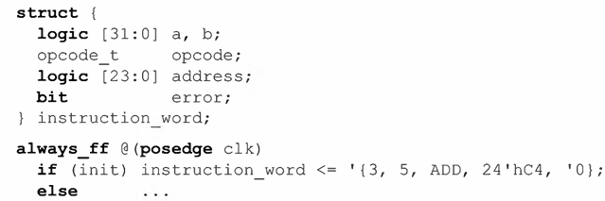
Structures
Assigning to entire structures
Notes:
Use a struct when you just need to group related signals inside a module/class.
Use an interface when you want to connect multiple modules with a clean, single port and possibly embed protocol behavior.

Slide 6
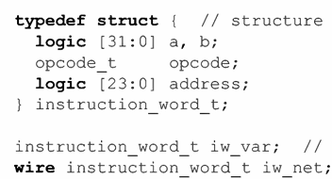
Structures
Typed Structs
Notes:
Use a struct when you just need to group related signals inside a module/class.
Use an interface when you want to connect multiple modules with a clean, single port and possibly embed protocol behavior.

Slide 7
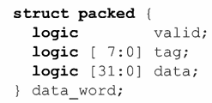

Structures
Packed Structs
Notes:
By default, a structure is unpacked.
Use an interface when you want to connect multiple modules with a clean, single port and possibly embed protocol behavior.

Slide 8

Structures
Packed Structs - can be treated as vectors. Can apply bit and part selects
Notes:
By default, a structure is unpacked.
Use an interface when you want to connect multiple modules with a clean, single port and possibly embed protocol behavior.

Slide 9

Structures
Structures and unions can include packed or unpacked arrays.
Notes:
By default, a structure is unpacked.
Use an interface when you want to connect multiple modules with a clean, single port and possibly embed protocol behavior.

Slide 10

Structures
A packed structure or union can only include packed arrays.
Notes:
By default, a structure is unpacked.
Use an interface when you want to connect multiple modules with a clean, single port and possibly embed protocol behavior.

Slide 11
Structures
Packed and unpacked arrays can include structures
In a packed array, the structure or union must also be packed.
Notes:
By default, a structure is unpacked.
Use an interface when you want to connect multiple modules with a clean, single port and possibly embed protocol behavior.

Slide 12

Unions
A union is a single storage element that can have multiple data type representations.
Notes:
By default, a structure is unpacked.
Use an interface when you want to connect multiple modules with a clean, single port and possibly embed protocol behavior.

Slide 13
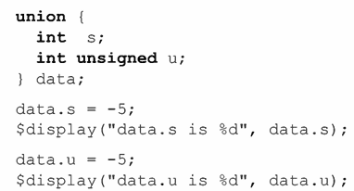
Unions
Assigning to, and reading from, union variables
Notes:
By default, a structure is unpacked.
Use an interface when you want to connect multiple modules with a clean, single port and possibly embed protocol behavior.

Slide 14
Unions
Unions could be anonymous or typed
could be packed, unpacked and tagged - Use packed as it is supported by all synthesis compilers
Notes:
By default, a structure is unpacked.
Use an interface when you want to connect multiple modules with a clean, single port and possibly embed protocol behavior.

Slide 15
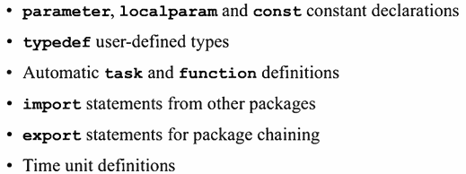
Packages
When a user-defined type is to be used in many different models, the typedef definition can be declared in a package.
Notes:
In RTL, procedural blocks executed in one cycle while Behavioral level takes multiple cycles.
Behavioral level uses full sys verilog with no restrictions while there are in RTL

Slide 16
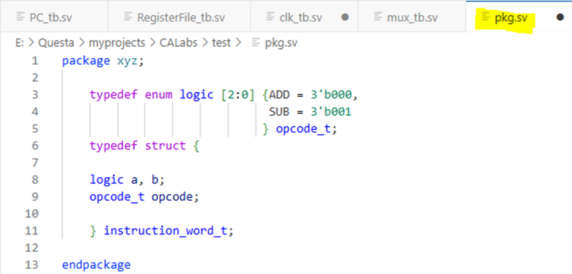
Packages
Notes:
In RTL, procedural blocks executed in one cycle while Behavioral level takes multiple cycles.
Behavioral level uses full sys verilog with no restrictions while there are in RTL

Slide 17
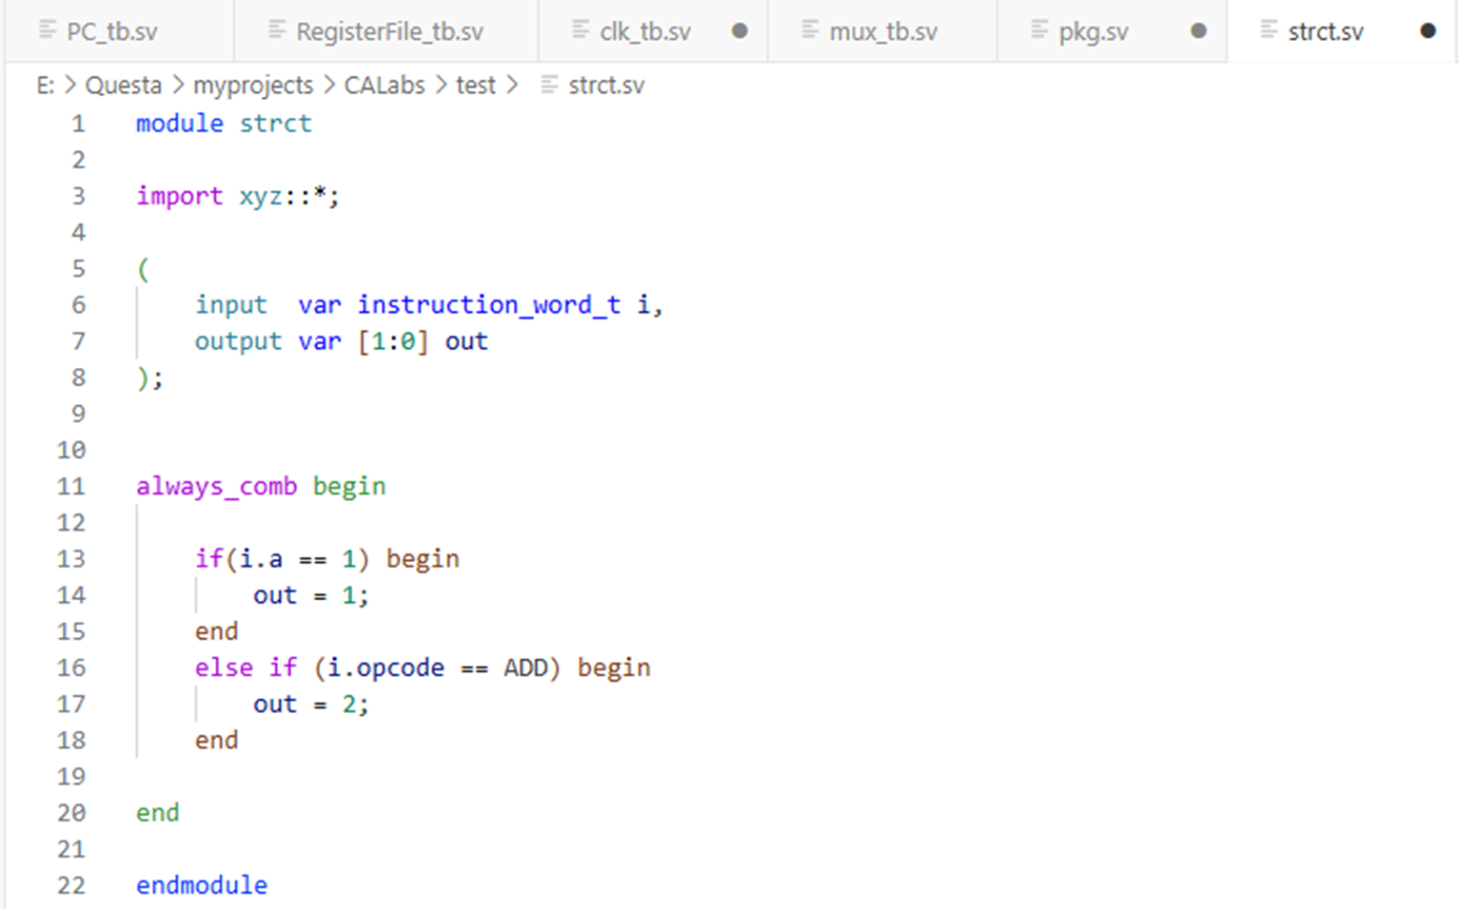
Packages
Notes:
In RTL, procedural blocks executed in one cycle while Behavioral level takes multiple cycles.
Behavioral level uses full sys verilog with no restrictions while there are in RTL

Slide 18
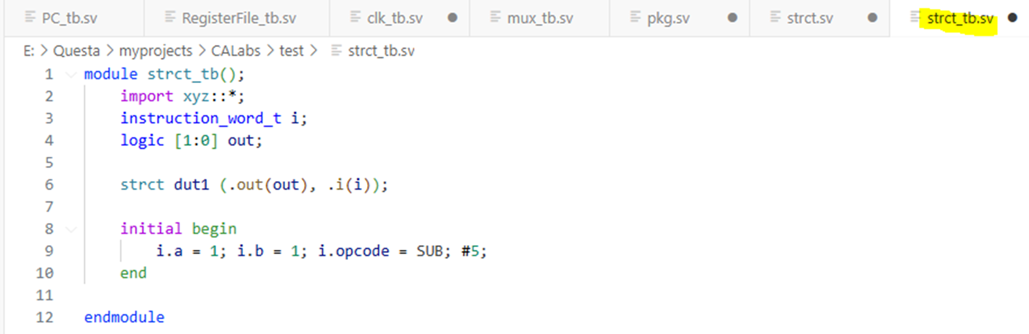
Packages
Notes:
In RTL, procedural blocks executed in one cycle while Behavioral level takes multiple cycles.
Behavioral level uses full sys verilog with no restrictions while there are in RTL

Slide 19
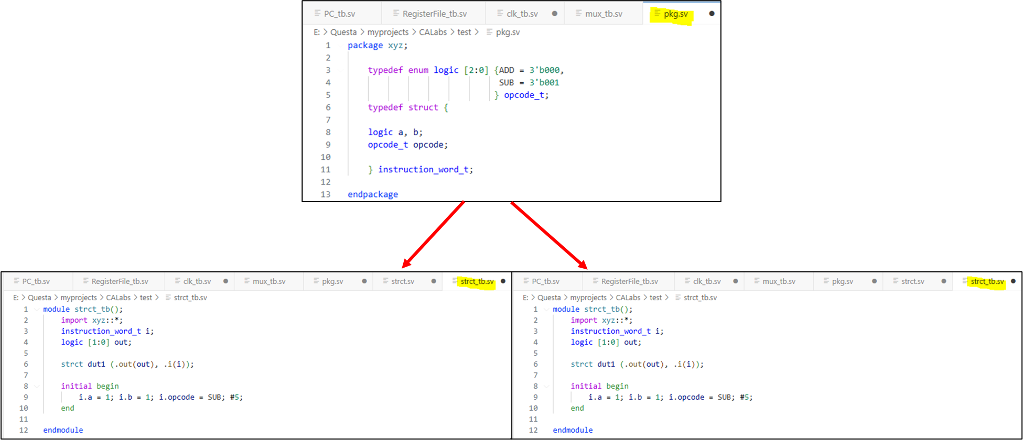
Packages
Notes:
In RTL, procedural blocks executed in one cycle while Behavioral level takes multiple cycles.
Behavioral level uses full sys verilog with no restrictions while there are in RTL

Slide 20

Modeling Latches and Avoiding Unintentional Latches
Use the RTL-specific always_latch procedure to model latch based logic. Do not use the generic always procedure in RTL models
Notes:
In RTL, procedural blocks executed in one cycle while Behavioral level takes multiple cycles.
Behavioral level uses full sys verilog with no restrictions while there are in RTL

Slide 21
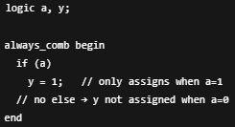

Modeling Latches and Avoiding Unintentional Latches
Synthesis will infer a latch whenever a non-clocked always procedure is entered, and there is a possibility that one or more of the variables used on the left-hand side of assignment statements will not be updated.
Notes:
In RTL, procedural blocks executed in one cycle while Behavioral level takes multiple cycles.
Behavioral level uses full sys verilog with no restrictions while there are in RTL

Slide 22
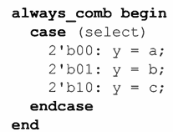
Modeling Latches and Avoiding Unintentional Latches
Incomplete decision statements — A decision statement is incomplete if it does not have a decision branch for every possible value of the decision expression.
Notes:
In RTL, procedural blocks executed in one cycle while Behavioral level takes multiple cycles.
Behavioral level uses full sys verilog with no restrictions while there are in RTL

Slide 23
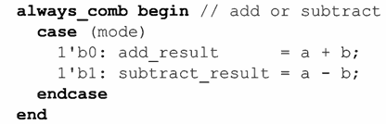
Modeling Latches and Avoiding Unintentional Latches
Incomplete decision branches — A decision branch is incomplete if it does not make assignments to all of the variables that are outputs of the procedure.
Notes:
In RTL, procedural blocks executed in one cycle while Behavioral level takes multiple cycles.
Behavioral level uses full sys verilog with no restrictions while there are in RTL

Slide 24
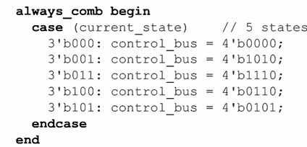
Modeling Latches and Avoiding Unintentional Latches
Inadvertent latches in state machine models
Notes:
In RTL, procedural blocks executed in one cycle while Behavioral level takes multiple cycles.
Behavioral level uses full sys verilog with no restrictions while there are in RTL

Slide 25
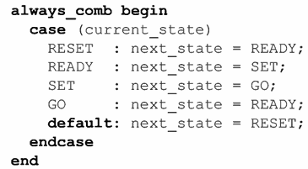
Modeling Latches and Avoiding Unintentional Latches
Synthesis warnings with always_comb
Latch avoidance style 1 — Default case item with known values
A latch could still be inferred if every branch of the case statement, including the default branch, does not assign to the same variables
Notes:
In RTL, procedural blocks executed in one cycle while Behavioral level takes multiple cycles.
Behavioral level uses full sys verilog with no restrictions while there are in RTL

Slide 26
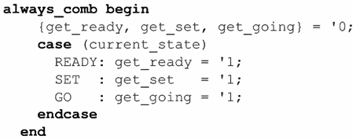
Modeling Latches and Avoiding Unintentional Latches
Latch avoidance style 2— Pre-case assignment, known values
it can be more difficult to see what is assigned to all the variables used by the procedure by looking at a specific case item branch.
It is necessary to look at both the pre-case assignment and the case item assignments to see all the values assigned
Notes:
In RTL, procedural blocks executed in one cycle while Behavioral level takes multiple cycles.
Behavioral level uses full sys verilog with no restrictions while there are in RTL

Slide 27
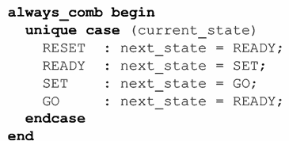
Modeling Latches and Avoiding Unintentional Latches
Latch avoidance style 3 — unique and priority decision modifiers
A gate-level implementation that is not robust, and can have unpredictable or undesired behavior
Notes:
In RTL, procedural blocks executed in one cycle while Behavioral level takes multiple cycles.
Behavioral level uses full sys verilog with no restrictions while there are in RTL

Slide 28
AMBA
an open-standard, on-chip interconnect specification for the connection and management of functional blocks in system-on-a chip (SoC) designs.
AMBA protocols define how functional blocks communicate with each other
Notes:
In RTL, procedural blocks executed in one cycle while Behavioral level takes multiple cycles.
Behavioral level uses full sys verilog with no restrictions while there are in RTL

Slide 29
AMBA
Why AMBA
Efficient IP reuse
Flexibility
Compatibilty
Notes:
c - AMBA lets different IP blocks from different vendors work together.
f - AMBA can be used in different kinds of chips (fast ones, low-power ones, small ones, big ones).

Slide 30

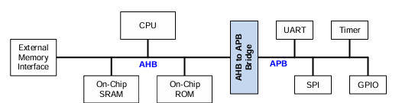
AMBA
AMBA flavors
Notes:
In RTL, procedural blocks executed in one cycle while Behavioral level takes multiple cycles.
Behavioral level uses full sys verilog with no restrictions while there are in RTL

Slide 31
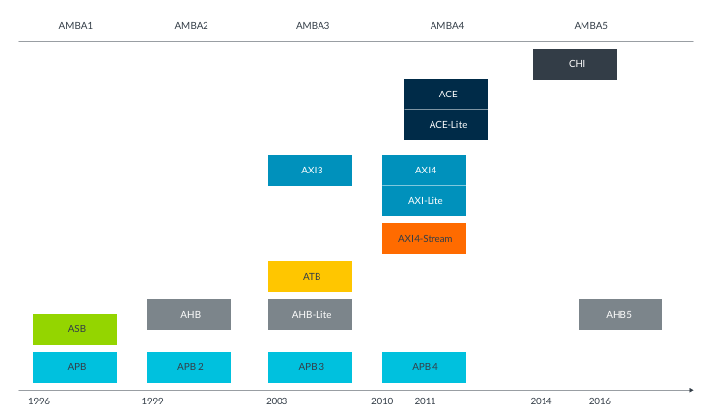
AMBA
How has AMBA evolved
Notes:
c - AMBA lets different IP blocks from different vendors work together.
f - AMBA can be used in different kinds of chips (fast ones, low-power ones, small ones, big ones).

Slide 32
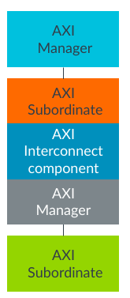
AMBA
Notes:
c - AMBA lets different IP blocks from different vendors work together.
f - AMBA can be used in different kinds of chips (fast ones, low-power ones, small ones, big ones).

Slide 33
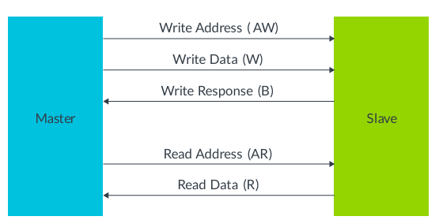
AMBA - AXI
AXI channels - Write Operation
The master sends an address on the Write Address (AW) channel and transfers data on the Write Data (W) channel to the slave.
The slave writes the received data to the specified address.
Once the slave has completed the write operation, it responds with a message to the master on the Write Response (B) channel.
Notes:
c - AMBA lets different IP blocks from different vendors work together.
f - AMBA can be used in different kinds of chips (fast ones, low-power ones, small ones, big ones).

Slide 34
AMBA - AXI
AXI channels - Read Operation
The master sends the address it wants to read on the Read Address (AR) channel.
The slave sends the data from the requested address to the master on the Read Data (R) channel.
The slave can also return an error message on the Read Data (R) channel.
Notes:
c - AMBA lets different IP blocks from different vendors work together.
f - AMBA can be used in different kinds of chips (fast ones, low-power ones, small ones, big ones).

Slide 35
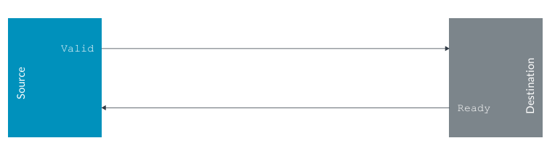
AMBA - AXI
Channel Handshake
The VALID signal must remain asserted, meaning set to high, until the destination accepts the information.
The destination indicates when it can accept information using the READY signal.
requires the rising edge of the clock for the handshake to complete
Notes:
c - AMBA lets different IP blocks from different vendors work together.
f - AMBA can be used in different kinds of chips (fast ones, low-power ones, small ones, big ones).

Slide 36
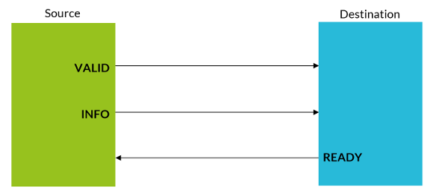
AMBA - AXI
Transfer vs Transaction
A transfer is a single exchange of information, with one VALID and READY handshake.
Notes:
c - AMBA lets different IP blocks from different vendors work together.
f - AMBA can be used in different kinds of chips (fast ones, low-power ones, small ones, big ones).

Slide 37
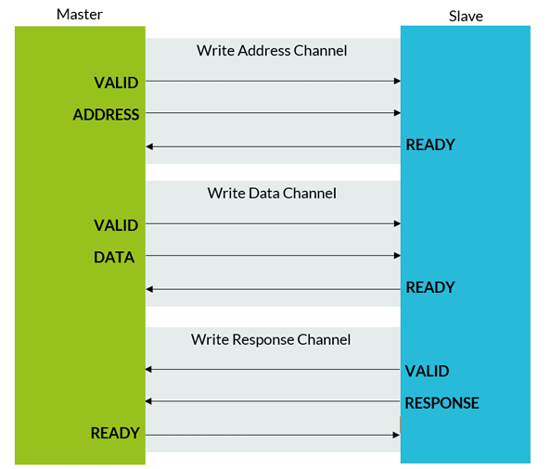
AMBA - AXI
Transfer vs Transaction
A transaction is an entire burst of transfers
Notes:
c - AMBA lets different IP blocks from different vendors work together.
f - AMBA can be used in different kinds of chips (fast ones, low-power ones, small ones, big ones).

Slide 38
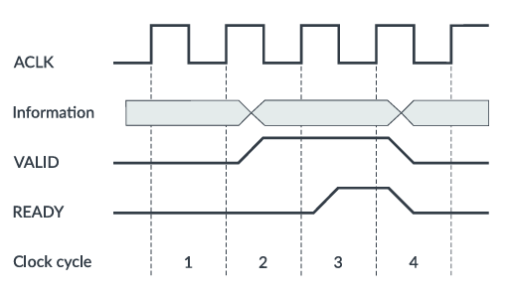
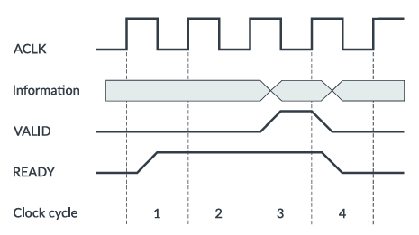
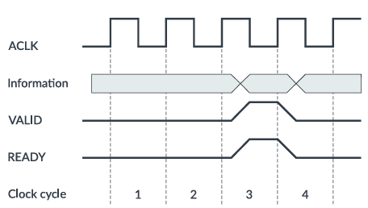
AMBA - AXI
Channel transfer examples - possible combinations of VALID and READY sequences that conform to the AXI protocol specifications.
Notes:
c - AMBA lets different IP blocks from different vendors work together.
f - AMBA can be used in different kinds of chips (fast ones, low-power ones, small ones, big ones).

